Slide 1


Project 4: TinyML
Machine learning and Deep learning AA 2022/2023
Teaching Assistants:
Niccolò Cavagnero (niccolo.cavagnero@polito.it),
Shyam Nandan Rai (shyamnandan.rai@studenti.polito.it)
Carlo Masone (carlo.masone@polito.it)
Giuseppe Averta (giuseppe.averta@polito.it),

Slide 2
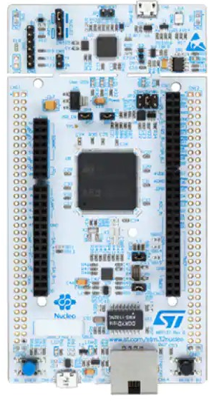
Tiny Machine Learning
Goal of the project
Practice of running machine learning algorithms on low-power microcontrollers that are commonly used in small devices such as wearables, sensors, and IoT devices.
Why is this relevant
Reduce data transmission to the cloud, lowering bandwidth requirements and energy consumption of devices.
Enhance privacy and security by minimizing the amount of sensitive data that needs to be transmitted and stored.
1

Slide 3
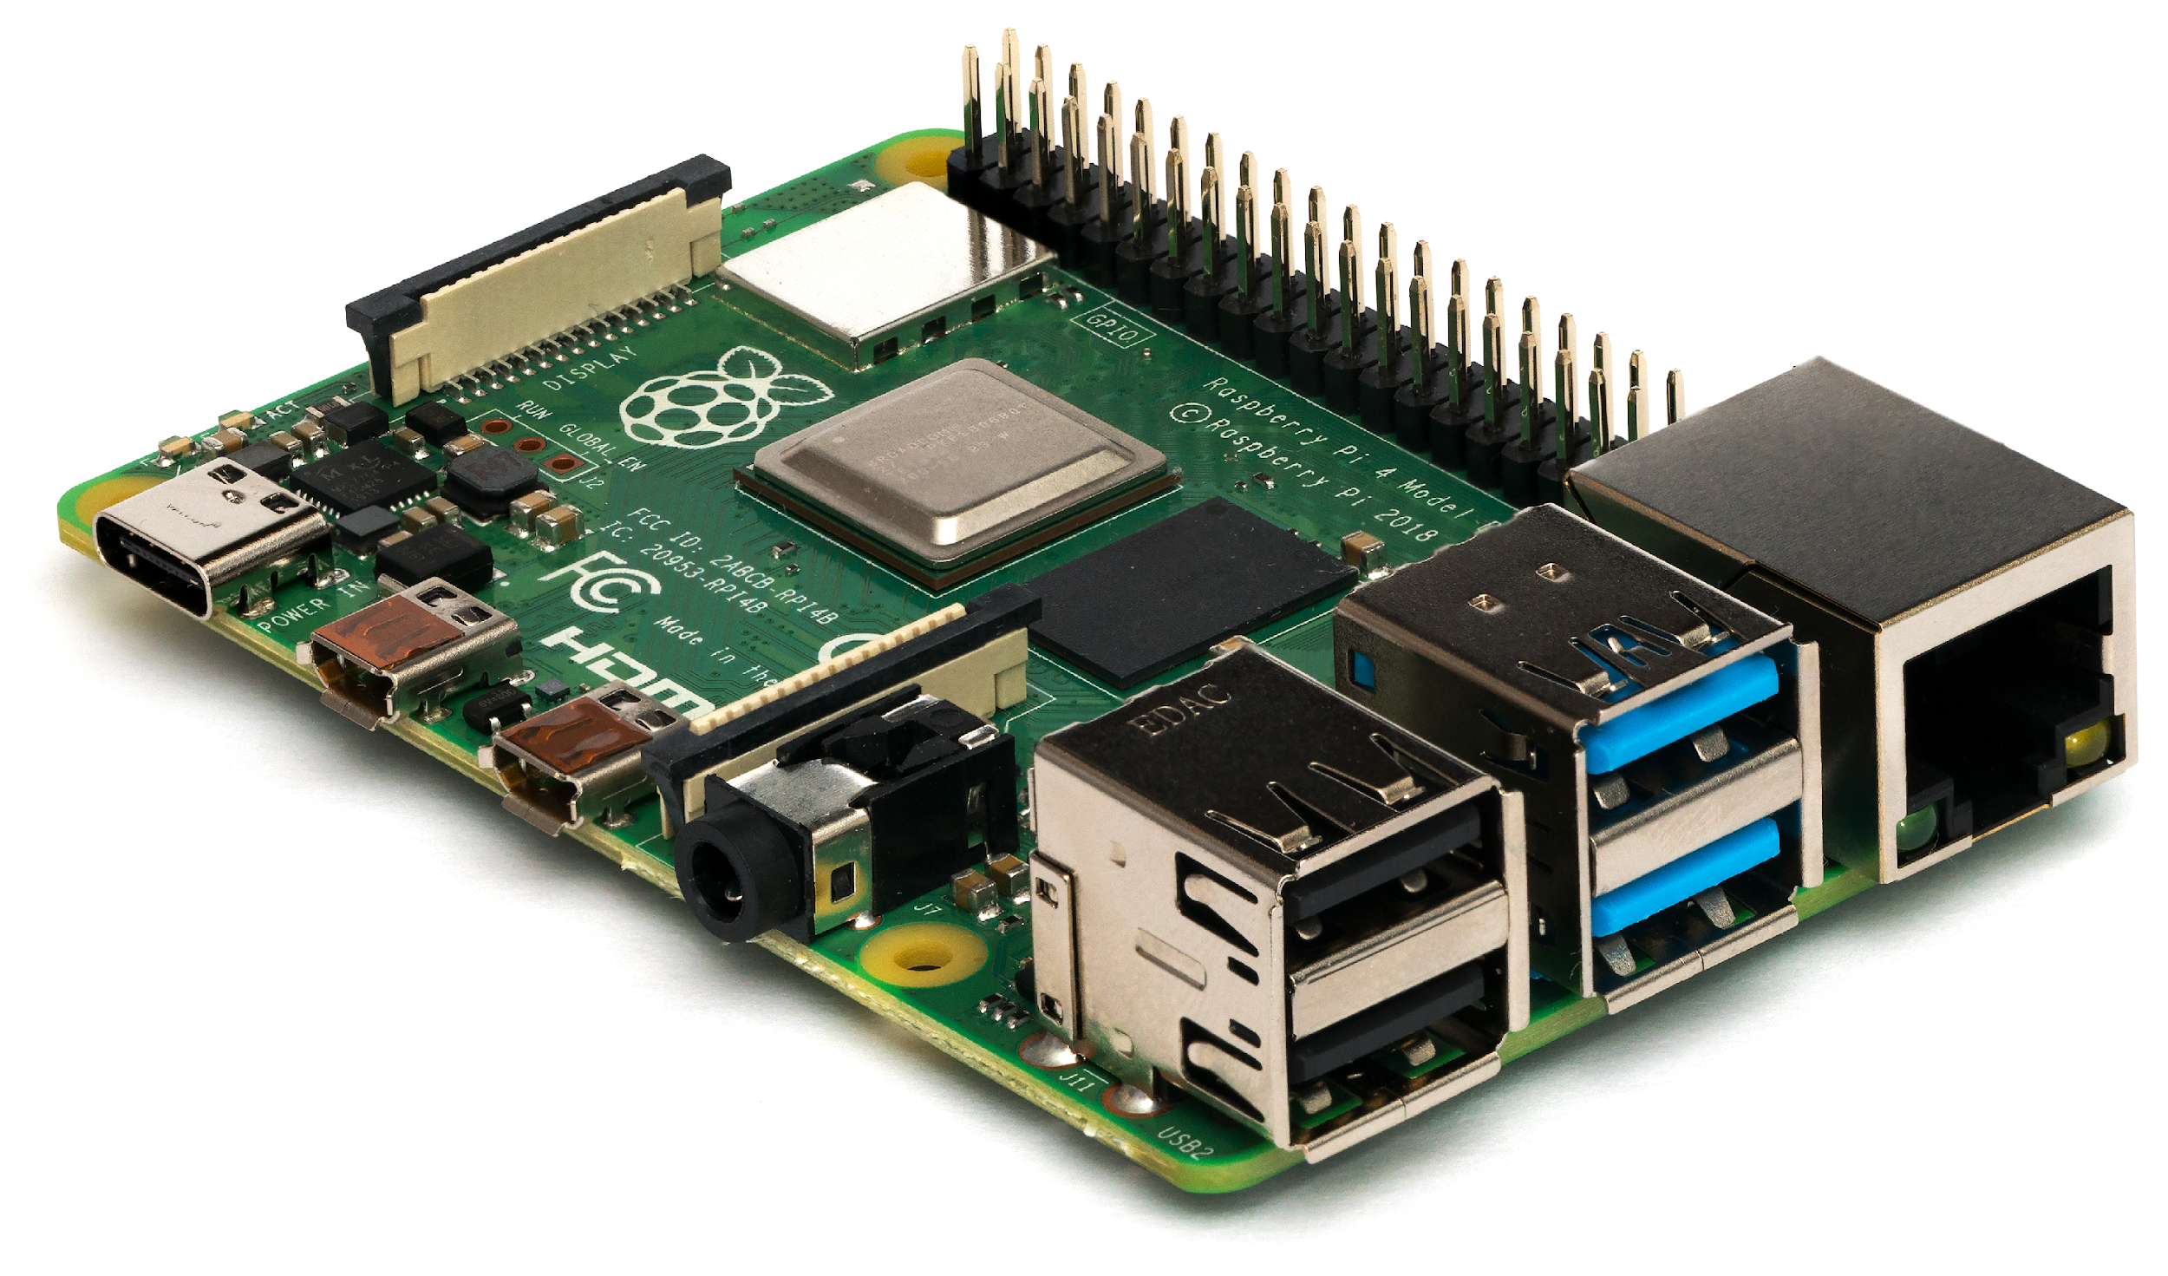
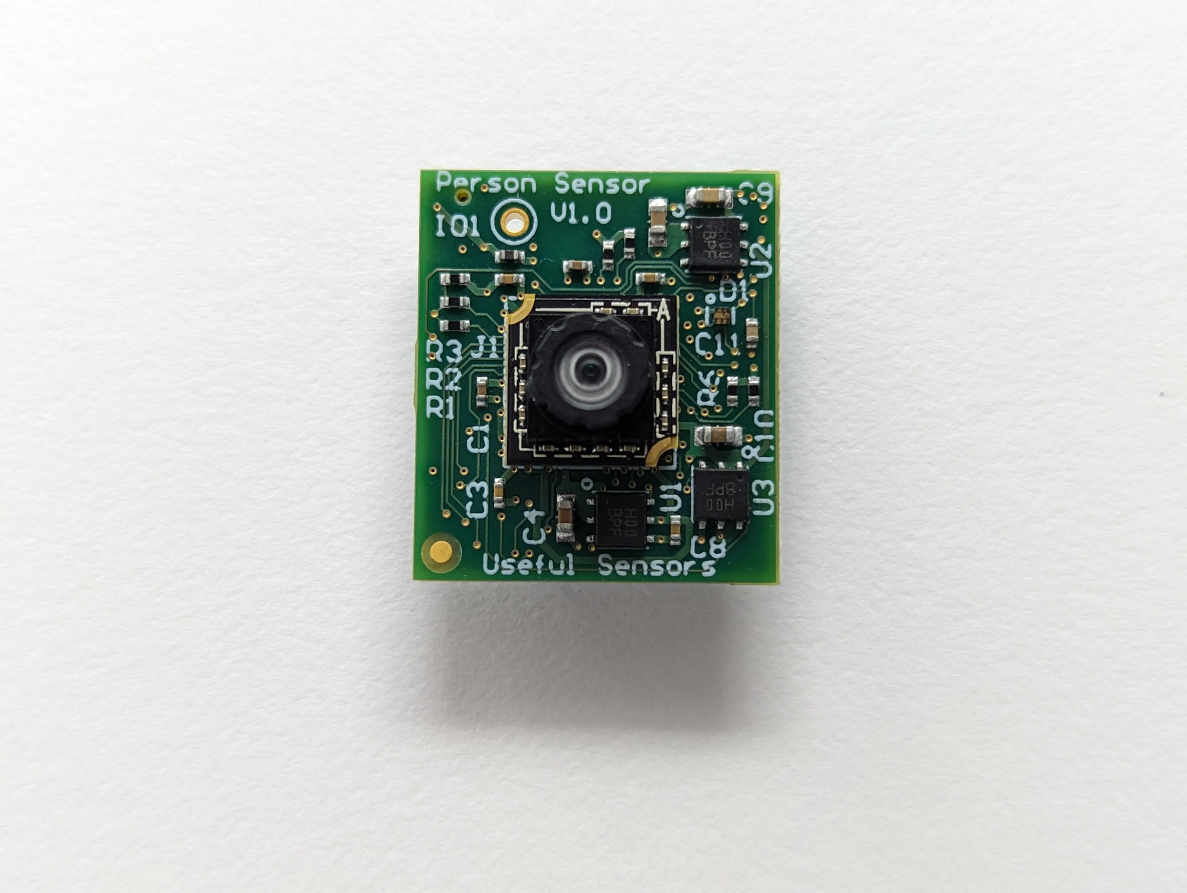
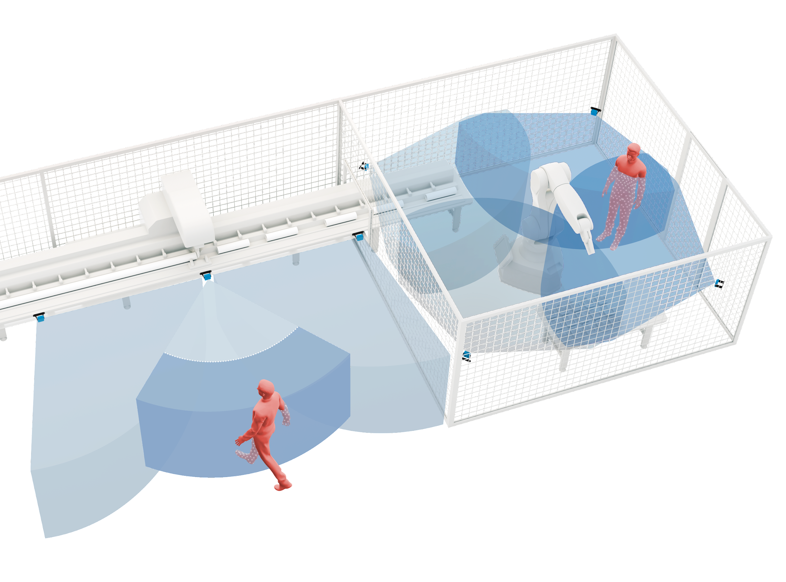
Tiny Machine Learning
Challenges
Low processing power
Limited working memory
Power consumption
Applications
Health monitoring
Smart Homes
Industrial Automation
Surveillance
2

Slide 4
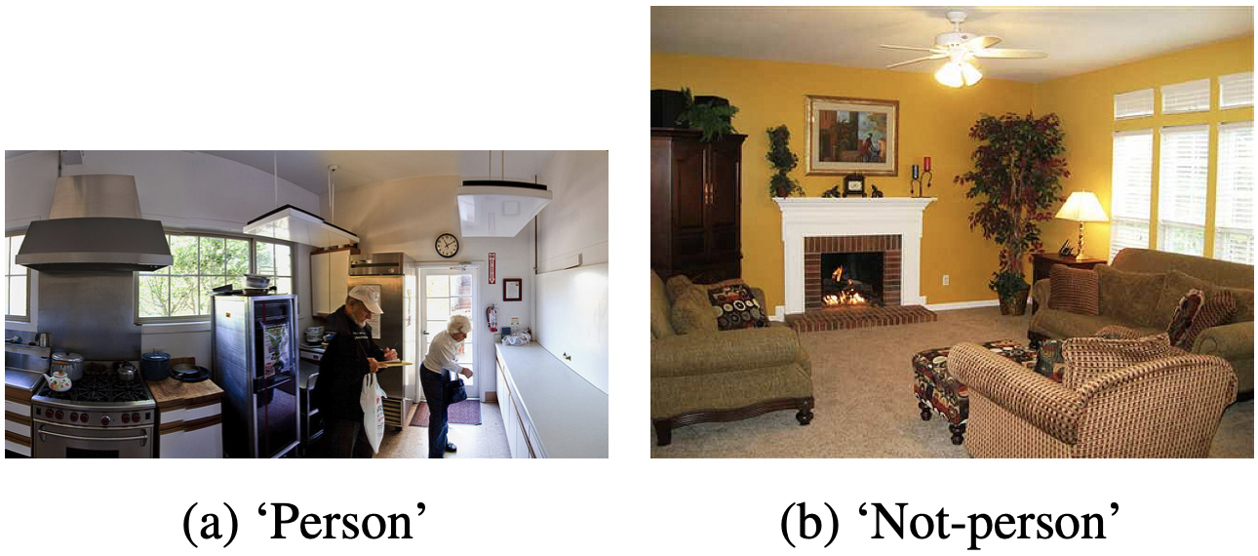
Project 4A: Neural Architecture Search
for Visual Wake Words
Visual Wake Words
Detection-like Benchmark for TinyML
Images are positively labeled if there are
people in the scene, negatively otherwise.
3

Slide 5
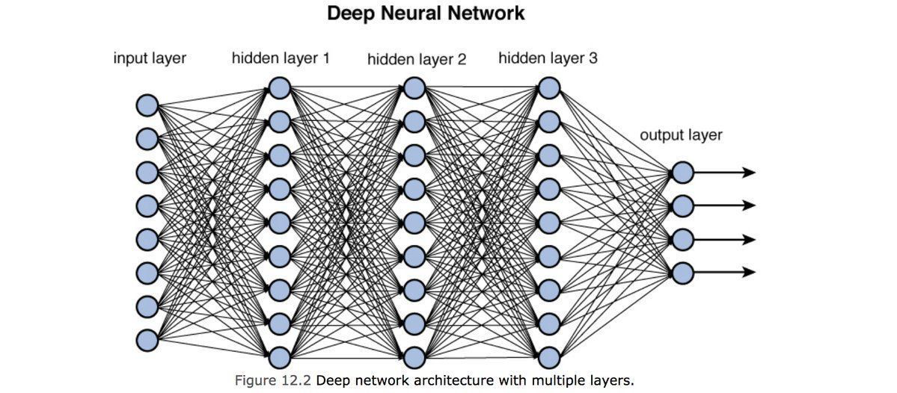
Project 4A: Neural Architecture Search
for Visual Wake Words
Goal of the project
Design a Tiny Deep Neural Network for Visual Wake Words
Explore the literature on DNN design.
Compare manual design vs Neural Architecture Search.
Achieve the highest possible accuracy while respecting hardware constraints.
4

Slide 6
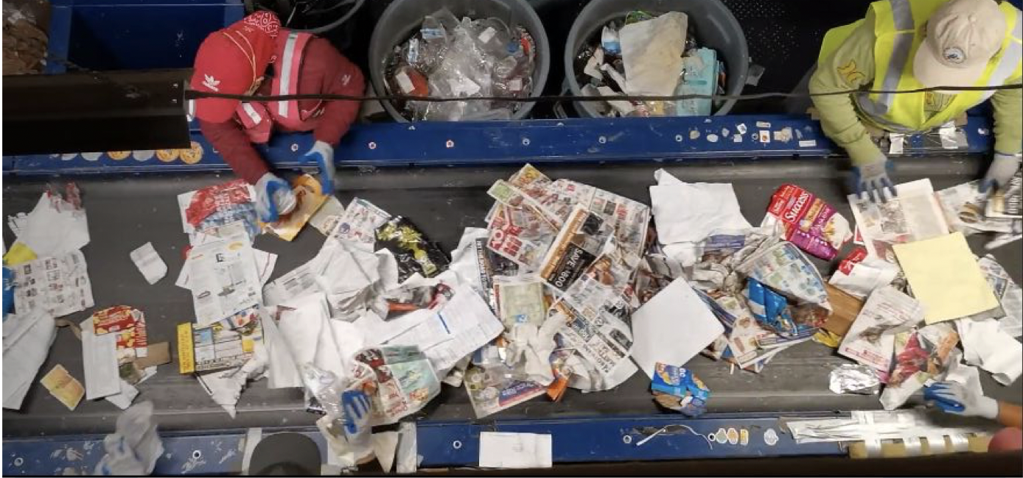
Project 4B: Resource Constrained Semantic
Segmentation for Waste Sorting
Motivation
Waste production is estimated to reach 2.6 billion tonnes a year in 2030.
Materials Recovery Facilities are where the collected recyclable waste is sorted into separate bales of plastic, paper, metal and glass.
However, these facilities require manual labour which is quite slow.
5

Slide 7
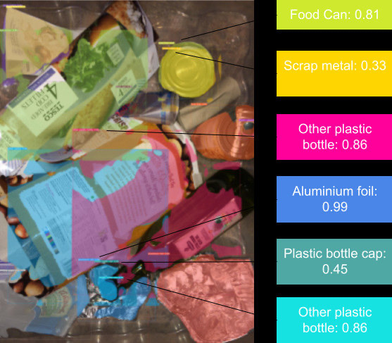
Project 4B: Resource Constrained Semantic
Segmentation for Waste Sorting
Goal of the project
Waste Segmentation is the pixel-wise labelling of an image containing recyclable waste object along with its class.
The task is achieved by training a semantic segmentation model on a recyclable waste dataset such as TACO and ReSortIT.
6

Slide 8
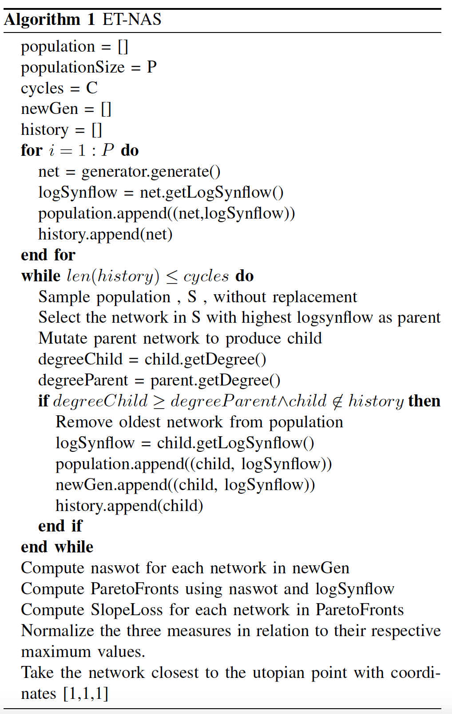
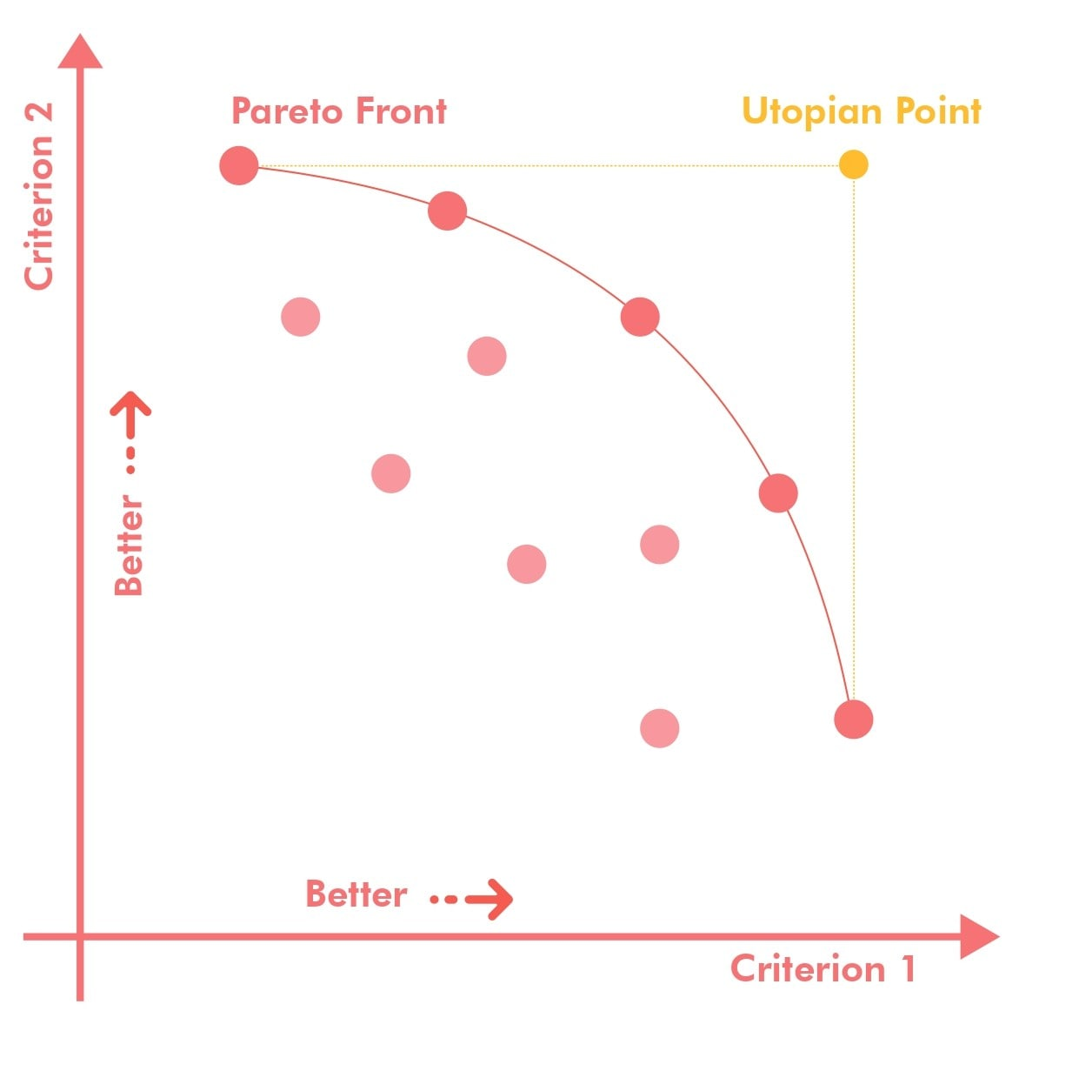
Example of previous year’s project
Use the Naswot score and LogSynflow as criteria and extract Pareto Front architectures
Evaluate also the LossSlope of Pareto Front architectures
Select the best architecture as the architecture nearer to the utopian point
The utopian point is the point [1,1,1] because we scale the values of the metrics by their maximum values.
7

